Slide 1
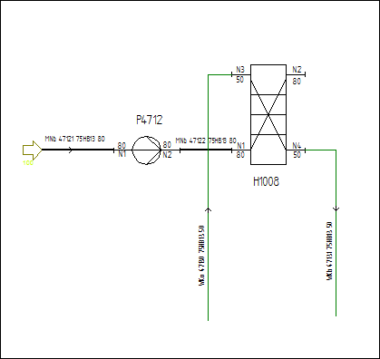
DEXPI Example Pump Plate Heat Exchanger
This is the DEXPI Example Centrifugal Pump P4712 Plate Heat Exchanger H1008

